Slide 1
Loops and Character Manipulation

Slide 2
Control Constructs: Loops
Loops are FORTRAN constructs that permit us to execute a sequence of statements more than once.
There are two types of loops:
While Loops
Code is repeated an undefined number of times until some user-specified condition is satisfied.
Iterative (or counting) Loops
Code is repeated a specified number of times.

Slide 3
The While Loop
DO
…
IF ( logical_expr ) EXIT
…
END DO
Block of statements between DO and END DO are repeated indefinitely until the logical_expr in the IF statement is executed.
Control then transfers to the first statement after the END DO
There may be more than one EXIT statement.
A good practice is have a single entry point and a single exit point.

Slide 4
CYCLE and EXIT Statements
DO index = istart, iend, incr
statement 1
statement 2
…
IF ( logical_expr ) CYCLE
…
IF ( logical_expr ) EXIT
…
statement n
END DO
When FORTRAN encounters a CYCLE statement in the body of the DO LOOP:
Execution of the current iterative cycle stops
Control is returned to the top of the DO LOOP
The loop index will be incremented
execution will resume again if the counter has not reached it’s limit.
When FORTRAN encounters a EXIT Statement
Execution of the loop is halted
Control is transferred to the first statement following the END DO
The EXIT and CYCLE statements can occur in either type of DO loop

Slide 5
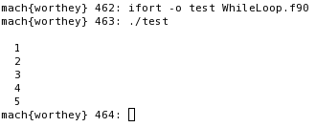
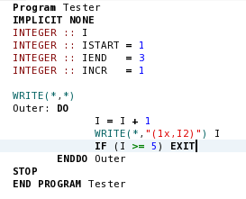
While Loop Example 1

Slide 6
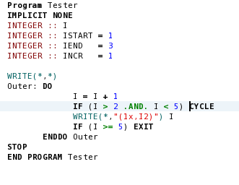

WHILE Loop Example 2

Slide 7
The DO WHILE Loop
DO WHILE ( logical_expr )
statement 1
statement 2
…
END DO
This is an alternate form of the WHILE loop.
The exit test must always occur at the top of the loop.
If logical_expr is TRUE, the statements inside the loop will execute.
If logical_expr is FALSE, control is passed to the first executable statement after the END DO
This is a special case of the more general WHILE loop.
No Reason to Ever Use It

Slide 8
The Iterative Loop
DO index = istart, iend, incr
statement 1
statement 2
…
statement n
END DO
This loops executes a code block a specific number of times.
The index, istart, iend, and incr parameters control the loop
index - counter
istart - initial value of the counter
iend - final value of the counter
incr - increment used to update index
incr is optional
If incr is not specified, assumed to be 1

Slide 9
Iterative DO Loop – How it Works
Each of the three DO loop parameters (istart, iend, incr) may be a constant, a variable, or an expression.
If a variable or an expression, the value is calculated before the start of the loop.
At the beginning of the loop the program assigns the value istart to the control variable index. If
index∙incr ≤ iend∙incr
then the program executes the statements within the body of the loop.
After the statements in the body of the loop have been executed, the control variable index is recalculated
index = index+ incr
Provided index is still ≤ iend, the program executes the statements within the body again.
The total number of iterations performed can be determined using the formula:
iter = (iend – istart + incr) / incr

Slide 10

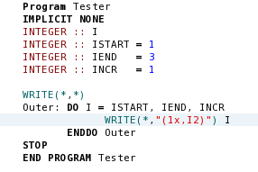
Iterative DO Loop Example 1

Slide 11
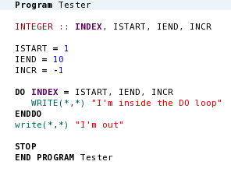
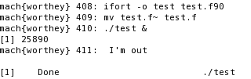
Iterative DO Loop Example 2

Slide 12
DO Loops – Operational Details
Indenting the body of the DO loop is strongly recommended to improve code readability.
The index variable of a DO loop must not be modified anywhere within the DO loop.
If the number of iterations calculated are less than or equal to zero, then the statements in the body will never execute.
It is possible for a DO loop to count down as well as up.
The index variable and control parameters of a DO loop should always be type integer.
It is possible to branch out of a DO loop at any time while the DO loop is executing.
When this occurs the index variable retains the value it had when the branch occurred.
According to the FORTRAN standard, the value of the index variable will be undefined when the loop is completed.
DON’T COUNT ON IT RETAINING ITS VALUE

Slide 13
Naming Loops
[name: ] DO index = istart, iend, incr
statement 1
statement 2
…
IF ( logical_expr ) CYCLE [name: ]
…
IF ( logical_expr ) EXIT [name: ]
…
statement n
END DO [name: ]
Name must begin with a letter.
Name can be up to 31 alphanumeric characters.
Must begin with a letter.
Including the name on CYCLE and EXIT statements is optional
Why do it ?
Helps the programmers and the compiler keep the DO loop straight.
Makes the programmers intentions explicitly clear
Helps the compiler flag the specific location of an error when one occurs

Slide 14
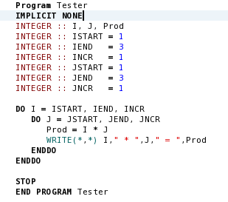
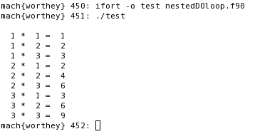
Nesting Loops
It is possible for one DO loop to be completely inside another DO loop (i.e. nested).
Note that the inner DO loop executes completely before the index variable of the outer DO loop is incremented.
When the FORTRAN compiler encounters an END DO statement, it associates that statement with the innermost currently open loop.
Naming the loops helps keep things straight and allows the compiler to catch errors in the nested structure.
If the DO loops are nested, they must have independent index variables
If two loops are to be nested, one must lie completely within the other.

Slide 15
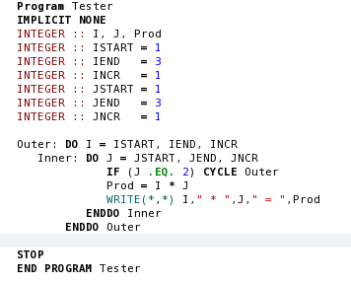
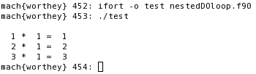
CYCLE and EXIT in Nested Loops
If a CYCLE or EXIT statement appears inside an unnamed set of nested loops then they refer to the innermost loop containing them.
Specifying the loop name with the CYCLE or EXIT indicates which loop the statement refers to.

Slide 16
Character Assignments and Manipulations
Character data can be manipulated using character expressions.
A character expression can be any combination of valid character constant, variables, operators, and functions.
A character operator is an operator that yields a character result.
A character function is any function that yields a character result.
There are two basic types of character operators:
Substring specifications
Concatenation

Slide 17
Character Assignments
Character Assignments
Character expressions shorter than the variable will be padded with blanks
Character(10) :: Name
Name = ‘Aggiebbbbb’
Character expressions longer than the variable will be truncated, and the excess character length discarded
Character(2) :: Name
Name = ‘Ag’
Substring Specifications
Selects a portion of a character variable
Treats that portion as an independent character string
Name(2:4) = ‘ggi’
The substring points to the same memory location as the characters 2 thru 4 of Name

Slide 18
Character Manipulations
The Concatenation Operator (//)
Allows two or more strings or substrings to be joined together:
A = ‘TEST’ B=‘PT109’ C=‘TITLE’
D = B(1:1) // C(5:5) // A(3:4) // ‘ ‘ // B(3:5)
D = ‘PEST 109’
Comparing Characters using Relational Operators
Character strings can be compared in logical expressions
The result is a logical value of either .TRUE. Or .FALSE.
Character strings can not be compared with numbers
Comparison is based on the collating sequence of the characters
The collating sequence is the order in which they appear within a specific character set, Examples:
AAAAB > AAAAA
AB > AAAAC and AAAAA > AAAA

Slide 19
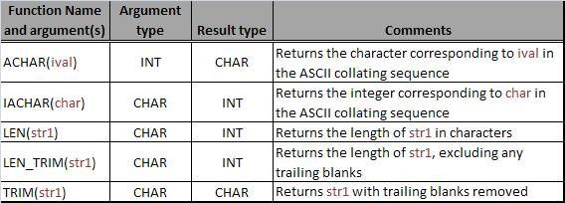
Character Intrinsic Functions
For a complete listing see Appendix B.7 in the back of your text

Slide 20
Good Coding Practice
Always indent code blocks in DO and IF blocks to make the code more readable.
Use the While loop to repeat sections of code when you don’t know in advance how many time you need to loop.
Use the counting DO loop to repeat sections of code when you know in advance how often the loop will be executed.
Never modify the value of the DO loop index while inside the loop.
Assign names to large complicated loops or IF constructs, especially if they are nested.
Use loop names with CYCLE and EXIT statements in nested loops to make certain that the proper loop is affected by the action of the statement.

